Slide 1
iBot
Final Presentation
Yun Ma, Young Liu,
Xiao Liang, Xuzhou Yin

Slide 2
Overview
Introduction
Requirements
Diagrams
Tools
Demo
Testing
Risk

Slide 3
Team
Team Members
Xiao Liang
Young Liu
Xuzhou Yin
Yun Ma
Points of Contact
Branden Bellanca
Email: bbellanca@netjets.com

Slide 4
Problem Statement
Some certain daily tasks employees do everyday require cumbersome steps and unnecessary complexity.
IBot aims to solve this problem, it is an intelligent bot which has Natural Language Processing service integrated and interacts with issue & project tracking tools like Jira, CRM tools like Salesforce, and continuous integration tools like Jenkins so that it helps turn inefficient steps into dialogs to increase productivity for all employees.

Slide 5
Approach
Agile
Use Jira to track progress and issues
Iterative development
Gather feedback from user in order to continously improve our product
Test driven development
Doing testing along with developing to ensure product quality

Slide 6
Functional Requirements
Respond when user joins
Ibot sents a greeting when a user is joining
Create cards/issues in Jira
Add summary
Move to current Sprint
Search cards/issues in Jira
Return matched issues rendered in Rich Info cards
Assign issue to user
Select one in members list
Change issue status
Can choose from any defined status in Jira
Set priority for each task
Cancel issue creatation
Choice to cancel a issue creation progress
Help command
List of possible features
Log in / Log out
Other features
Burn down rate
Sprint report

Slide 7
Non-Functional Requirements
Appearance: Simple style chat window
Various platform: Skype, Slack, Facebook
Time: Ibot responses user’s requests in less than 5 seconds.
Ibot service has at least 99% uptime
Service coule be able to scale up when demand increases
Users of the bot are able to complete the desired task in under 3 tries.
Ibot does not allow unauthorized user to access sensitive information

Slide 8
Use Case Examples
As a user, I want to know the abilities of the bot, so that I can choose what I need.
Functions: /Help for possible features.
As a user, I want to add details for my issues, so that I can record my work easily.
Functions: add title, add description, add priority and ‘assign to me’.
As a user, I want to check all my work cards, so that I know where I am and what to do next.
Functions: search issues - return cards in a row in the chatting windows.
As a user, I want to move my in-progress issues to done state, so that I know the work is finished.
Functions: change issue statue.
As a user, I want to assign tasks to my teammate to work collaborately.
Functions: assign issue to user

Slide 9
Out of Scope
Integrate with voice recognition to enable more intuitive interation.
Requires extra libraries, accuracies are low.
Some applications does not provide direct voice input method.
Define domain specific language (DSL) to eliminate the ambiguity in natural language.
Requires too much time to develop/test.
Increases the cost of learning.
Interact with more DevOps tools
Require much time, and need to do research on the API of each

Slide 10
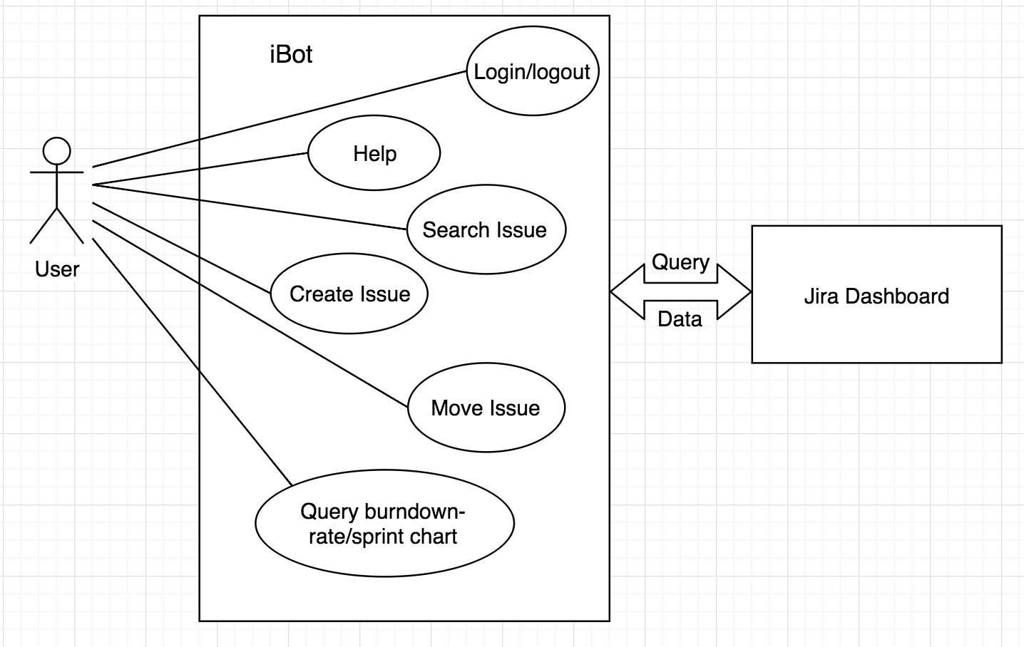
Use Case Diagram

Slide 11
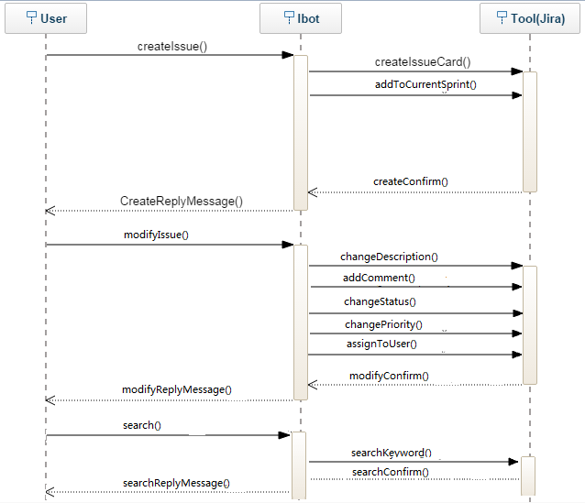
Sequence Diagram

Slide 12
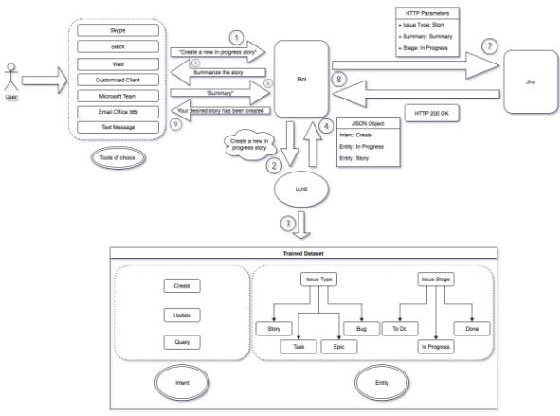
Architecture

Slide 13
Tools
Open source frameworks: BotFramework, Node.js and LUIS
Agile development supported platform: Jira
Version control & continuous integration: Git & Travis CI
Microsoft/Jira accounts
Heroku web service
Pre-defined LUIS model dataset
Documentation tools: Google Drive
Team communication tools: Google Hangouts / WeChat
Personal laptops & IDE: IntelliJ IDEA

Slide 14
[Demo]

Slide 15
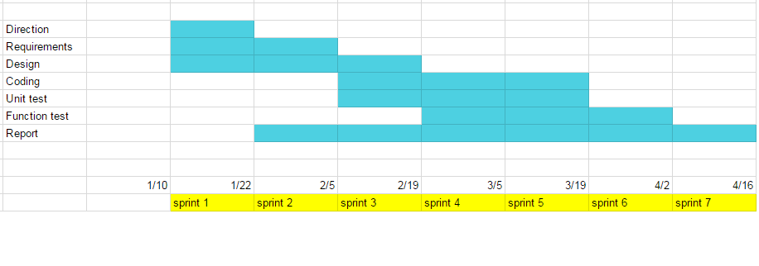
Project Schedule

Slide 16
Testing
Unit testing
Mocha: A flexifble and descriptive Javascript testing framwork
Tests simple bot logic as well as business system interaction
Enables continuous integration with Travis CI
User acceptance testing
For more complex logic.
Involves human interaction.
Able to use Emulator or Skype to test.

Slide 17
Use Case Testing
ID | Use case | Description | Status
1 | Log in | Type command “LOGIN” iBot asks for username, password and project url If informations are corret, user can type command; if not, iBot sends a error message | Passed
2 | Create an issue | Type command “create an issue” iBot displays a list of projects Type the number of the selected project iBot then displays a list of issue type Type the number for one of the types iBot asks for summary of issue | Passed
3 | Modify a field | Type command “modify issue” iBot asks for keyword of related card Type related keywords iBot displays a list of cards Type the number of one card iBot asks the fields user want to modify | Passed

Slide 18
Use Case Testing(cont.)
ID | Use case | Description | Status
4 | Search with keywords | Type command “search” iBot asks for keywords Type related keywords If there are related issues, iBot returns a list of cards that can be viewed in browser; if not, iBot sends a failure message | Passed
5 | Ask for valid burn down rate | Type command “burn down rate” iBot displays a list of projects Type the number of the selected project If burn down rate exists, iBot returns the value of the burn down rate; if not, iBot sends a failure message | Passed

Slide 19
Risks
Fuzzy search not accurate enough. May need enhance the algorithm
Sometimes iBot renders some irrelevant results when user searches issues
Sign in process is not secure enough
Password is not coverred by dots
LUIS limits the number of times user can interact with iBot
One thousand times per month, but can be more if it gets paid

Slide 20
Future Extension
integrating more DevOps tools
BitBucket
Jenkins
Salesforce
Customized features
View calendar
Check emails
Write summary
Vocie input
voice recognition
Group chat with multiple users
iBot takes notes at group meetings

Slide 21
Lesson Learned
Don’t be afraid to learn a new technology/tool
Most open source tools have user guide and API in order for us to use
Process of software development may take longer than we think
A project is not just the product. It requires more (eg. Documentation, Test cases)
User is the most important!
User determines what the product should be like, not developers!
Agile Methodology makes it much clearer to track the progress of a project
Jira cards always tells us what we need to do now, what we should finished soon

Slide 22
Thanks!

